Slide 1


Department Faculty Timetable and Duty Management System
KOLHAPUR INSTITUTE OF TECHNOLOGY'S COLLEGE OF ENGINEERING, KOLHAPUR.
DEPARTMENT of CSE(AIML)
Presented by: A18 – Neha Jagtap
A45 – Sakshi Patil
A64 – Vaishnavi Benake
Under guidance of : Dr. Pradeep S. Khot
Mrs. Sapana Buwa

Slide 2

Introduction
Overview of the Project
This project focuses on managing faculty timetables and duties in a college.
It provides a centralized system for scheduling lectures, labs, and duties.
The system reduces manual work and improves efficiency.
Why This Project Topic
Objectives
To automate faculty timetable generation.
To manage teaching and non-teaching duties efficiently.
To reduce scheduling conflicts and manual errors.
To reduce faculty,room and division scheduling clashes.
Problem in Manual System | Solution in Our System
Time-consuming timetable creation | Auto-generation & manual timetable entry
Clashes & workload imbalance | Clash-free scheduling logic
Hard to track leaves & duties | Centralized leave & duty management
No role-based access | Secure login with Admin/Faculty/Student roles

Slide 3

Problem Statement
Traditional faculty and departmental management systems mainly depend on manual record keeping, which leads to inefficiency, increased paperwork, and difficulty in managing large amounts of data.
Manual timetable preparation and duty allocation often result in scheduling conflicts, workload imbalance, and human errors that affect departmental operations.
Lack of a centralized system makes it difficult to manage faculty, subjects, divisions, rooms, leave records, duties, and timetable entries efficiently.
Generating timetable reports and maintaining records manually becomes time-consuming and less accurate in traditional systems.
Managing faculty workload, room allocation, and subject scheduling manually can reduce overall departmental productivity and consume more administrative effort.
Therefore, there is a need for an automated Department Faculty and Duty Management System that can simplify administrative tasks, improve accuracy, reduce manual workload, and enhance overall departmental efficiency.

Slide 4
Where we can use?
Educational Institutions
Department Faculty and Duty Management System can be used in colleges, universities, schools, and polytechnic institutes to manage faculty records, timetable scheduling, subject allocation, and departmental duties efficiently.
Department Administration
The system is useful for department offices to automate faculty workload management, timetable generation, leave management, duty assignment, and academic planning activities.
Multi-Campus Institutions
Large educational organizations with multiple campuses can use the system to centrally manage faculty information, schedules, and departmental operations across different locations.
Training and Coaching Centers
Coaching institutes and training centers can utilize the system for faculty scheduling, batch management, subject assignments, and maintaining staff records.
Government Educational Organizations
Government education departments and public institutions can use the system to improve administrative efficiency, maintain accurate faculty databases, and reduce manual paperwork.

Slide 5
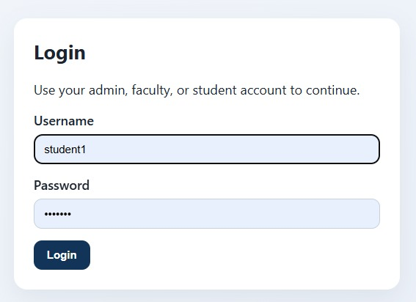
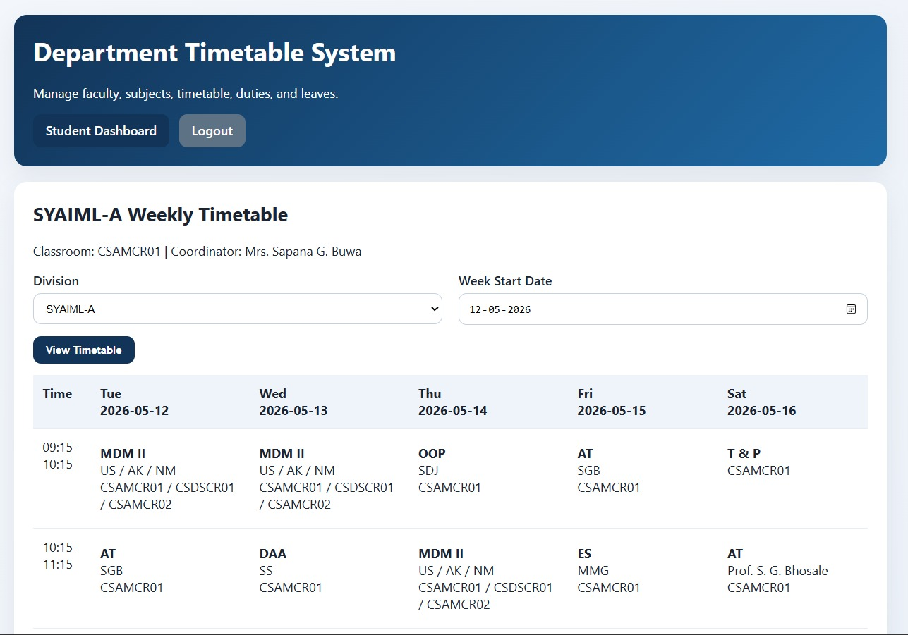
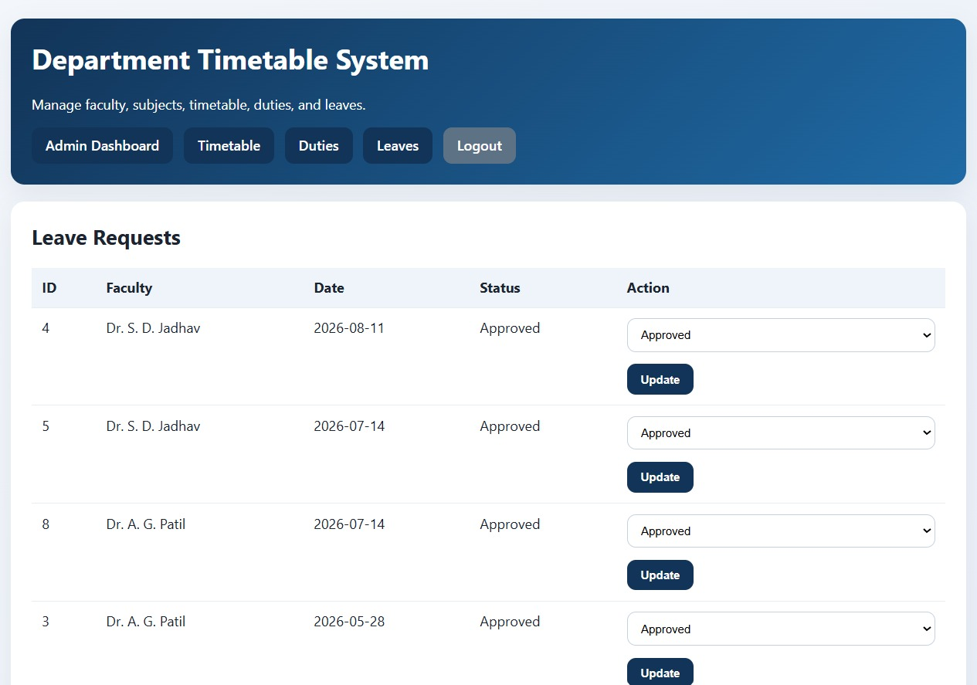
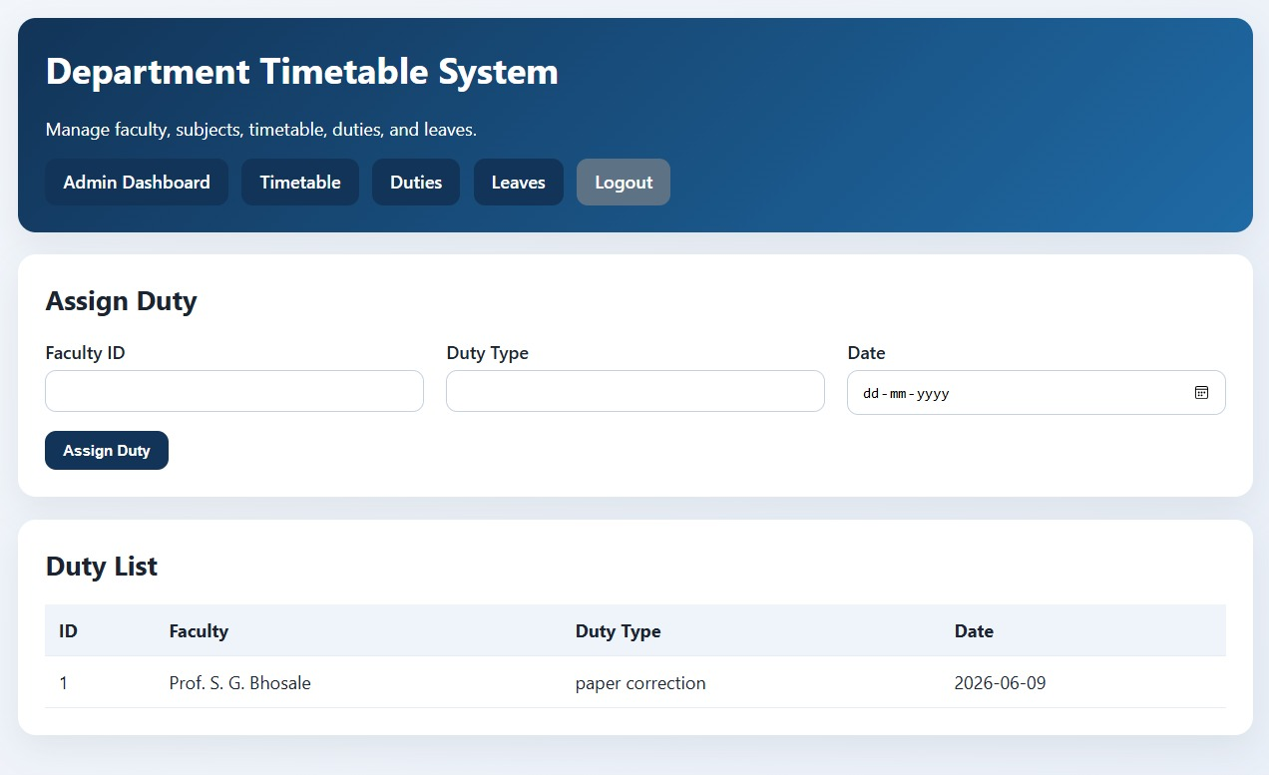
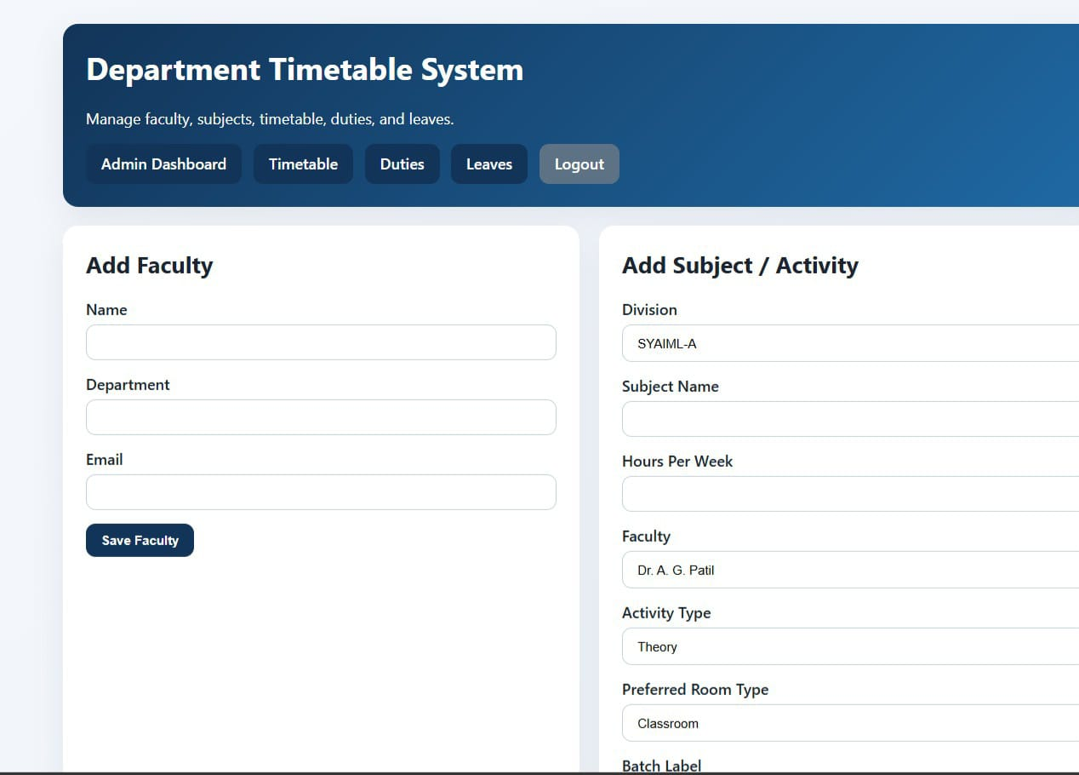
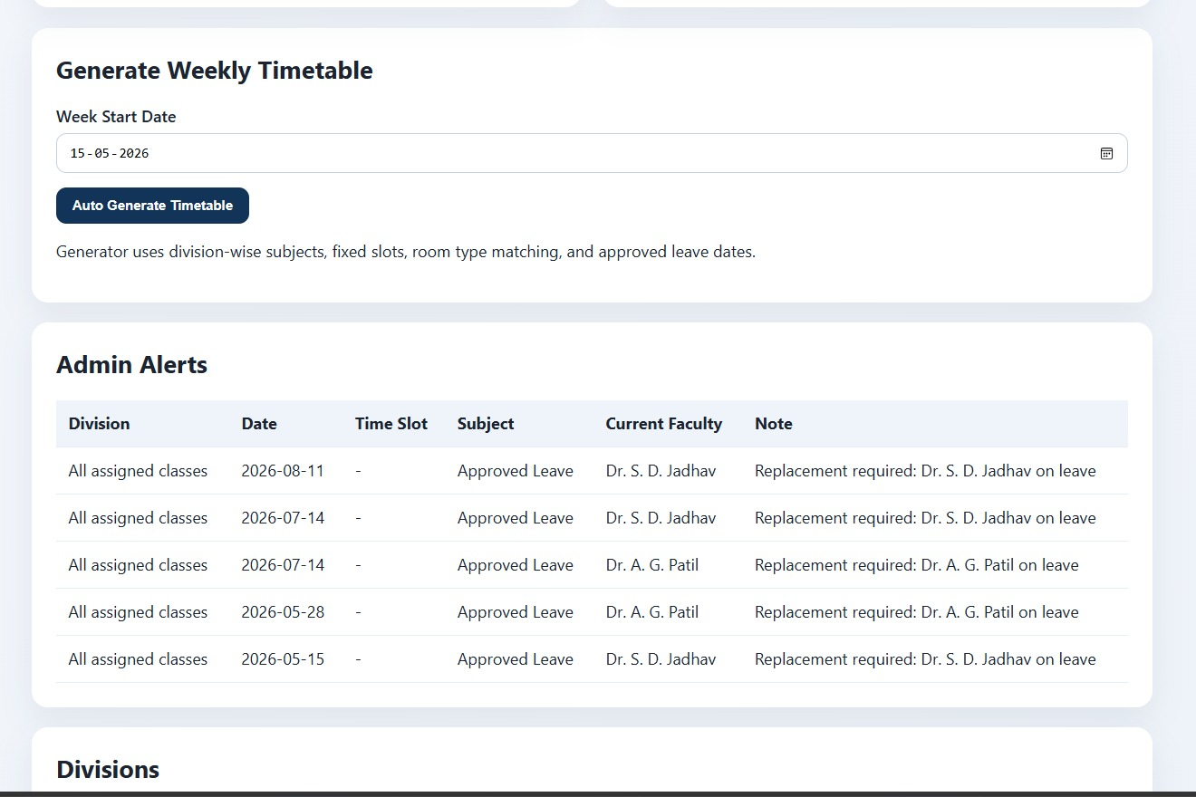
Working Model

Slide 6
Literature Review
Our research into existing solutions revealed a variety of approaches, each with unique strengths and limitations, guiding our system's design.
Title & Year | Authors | Limitations | Tools & Technologies
Time Table Management System (SSRN, 2023) | Usman Khan, Muhammad Suleman, Saeed Ullah Jan | • Depth of evaluation unclear • Few details on scalability or user testing reported | Android Studio (Java/Kotlin) • SQLite database • Android OS • PHP/MySQL mentioned for backend in some versions
Academia Timetable Management System: A Review (IJCRT2212458, 2022) | Aniket Pawar, Aditya Chavan, Akib Mulla, Omkar Musmade, Suparna S. Naik | •Attendance is entered manually • Not fully automated in some features • Based on simple Android app, doesn’t use advanced algorithms | •Android (Java) • XAMPP • VS Code • MySQL database • SQLite
Limitations of Existing System
Slow for large organizations
Cannot handle sudden changes
Hard to change rules Not easy to understand results
Tested only in theory

Slide 7
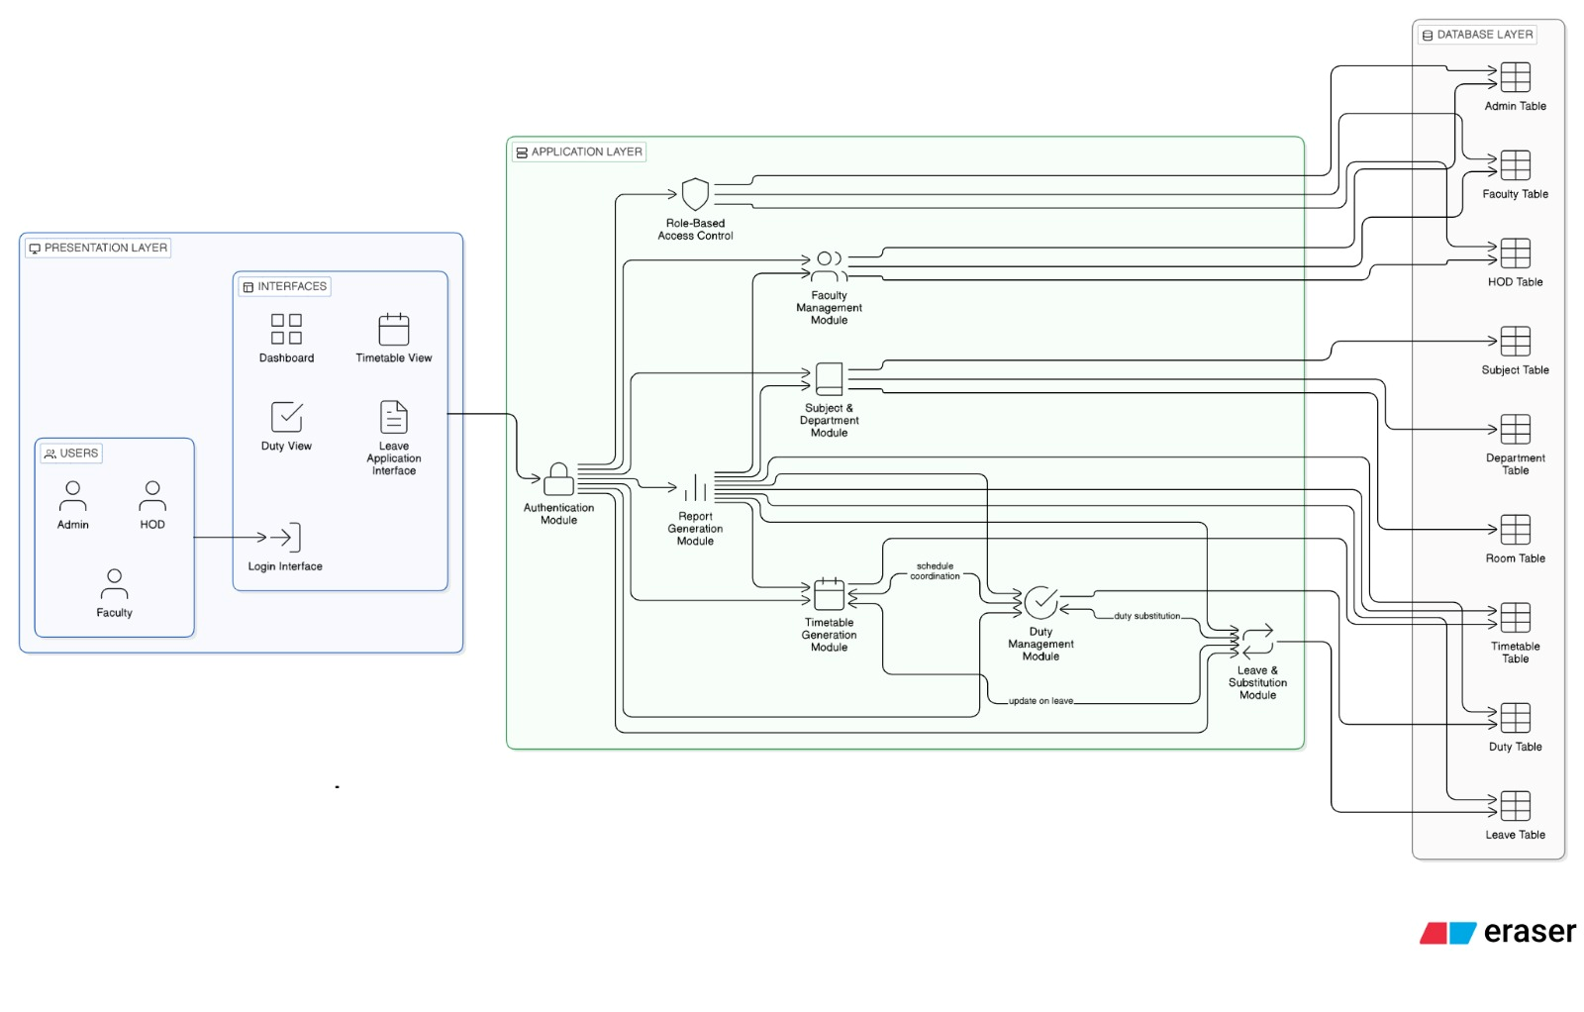
System Architecture

Slide 8

Implementation Details
Front-End: Developed using HTML, CSS, JavaScript, and JSP to create a dynamic and user-friendly interface for Admin, Faculty, and Students.
Back-End: Implemented using Java (Servlets and JSP) to manage application logic, process user requests, and handle timetable generation efficiently.
Database: MySQL is used to store and manage data such as faculty details, subjects,divisions,users,rooms,time slots,subjects, timetable entries,fixed activities,duties and leave records in structured manner.
Database Connectivity: JDBC is used to establish a secure connection between the Java application and the MySQL database for data operations.
Web Server: Apache Tomcat 9 is used to deploy and run the web application, handling client requests and server responses.
Build Tool: Maven is used for project build automation and dependency management, ensuring smooth development and deployment.
IDE: IntelliJ IDEA is used as the development environment for coding, debugging, and managing the entire project efficiently.

Slide 9
Modules Implemented
Admin Module : Add and manage faculty details,subjects,classrooms and generate timetables.
Timetable management Module : Generates timetable entries and allow admin to add timetable entries while avoiding clashes.
Duty management Module : Assigns duties such as paper correction,exam duty,events or other assigned work to faculty.
Faculty Module : Allows faculty members to view their timetable and assigned duties.
Output : Displays organized faculty timetables and duty schedules in a clear structured format.

Slide 10
Successfully automated faculty and departmental duty management processes.
Reduced paperwork, manual effort, and administrative workload.
Improved accuracy in timetable scheduling and duty allocation.
PDF timetable export and easy access to timetable,leave and faculty records.
Centralized and secure database management for faculty information.
Enhanced departmental efficiency, transparency, and resource utilization.
Result and Analysis

Slide 11
Future Work
The system can be enhanced by implementing AI or optimization-based timetable generation to reduce scheduling conflicts and improve workload distribution among faculty members.
Mobile application support can be added to allow faculty and administrators to access schedules, duties, notifications, and reports anytime and anywhere.
Cloud database integration can improve data storage, backup, scalability, and remote accessibility for multiple departments and campuses.
SMS and Email notification features can be implemented to provide instant updates regarding timetable changes, meetings, duties, and departmental announcements.
Advanced analytics and dashboard modules can be added to monitor faculty performance, workload analysis, and departmental efficiency through graphical reports and statistics.

Slide 12
Conclusion
The Department Timetable and Duty Management System provides an efficient, reliable, and automated solution to manage academic schedules and duties. By reducing manual workload and improving accuracy, the system enhances better academic planning and easier access for admin, faculty, and students.

Slide 13
Thank You…..

